Slide 1
The OpenAIRE Graph
Cooking and Cutting the DH Slice!
Alessia Bardi (CNR-ISTI, Italy)
Paolo Manghi (OpenAIRE, CNR-ISTI)
https://connect.openaire.eu/
Some of these slides are kindly shared by Giulia Malaguarnera (OpenAIRE AMKE)

Slide 2
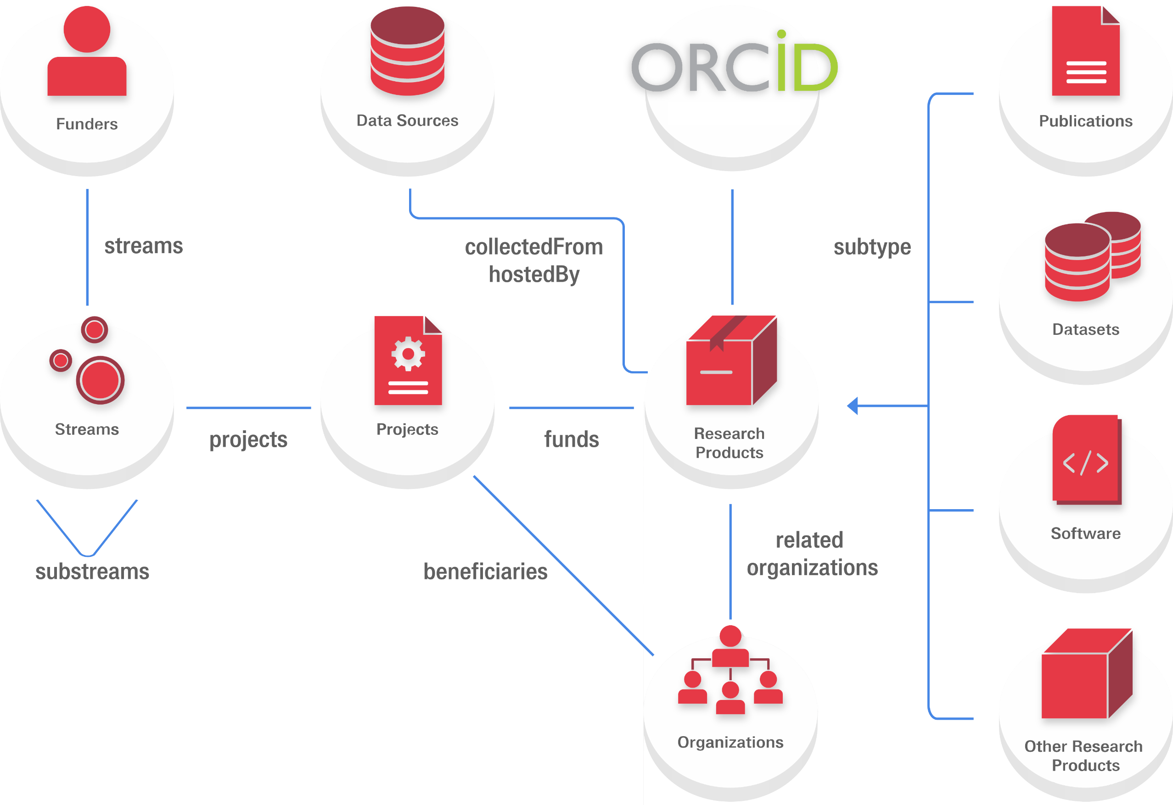
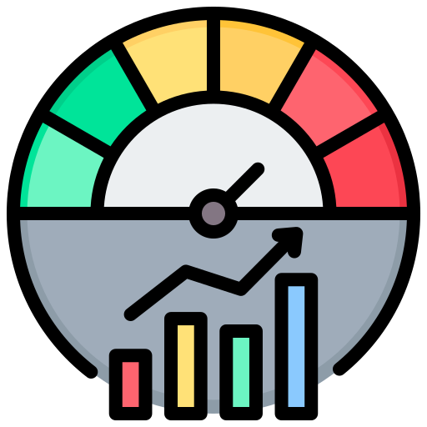
The OpenAIRE Graph
Key Asset In Open Science Infrastructure Inclusive, Transparent, Reproducible
Persons
Cites
VersionOf
SupplementTo
RefersTo
Based on Open Science principles
High relevance to the research community
indicators
2

Slide 3
Sources of the OpenAIRE Graph
… and more aggregators
… and more registries
… and more tools and software sources
… and more European
and international funders
… and more einfra and RI sources
… and more thematic and institutional repositories
… and more research graphs
… and more publishers

Slide 4
Research communities, organisations, universities and their alliances, need tools to discover, assess and outreach their research findings.
When you don’t have a dedicated system to track and monitor your customers, they’ll start to feel underappreciated and unloved.
4

Slide 5
Enter OpenAIRE CONNECT
https://connect.openaire.eu
5

Slide 6
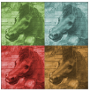
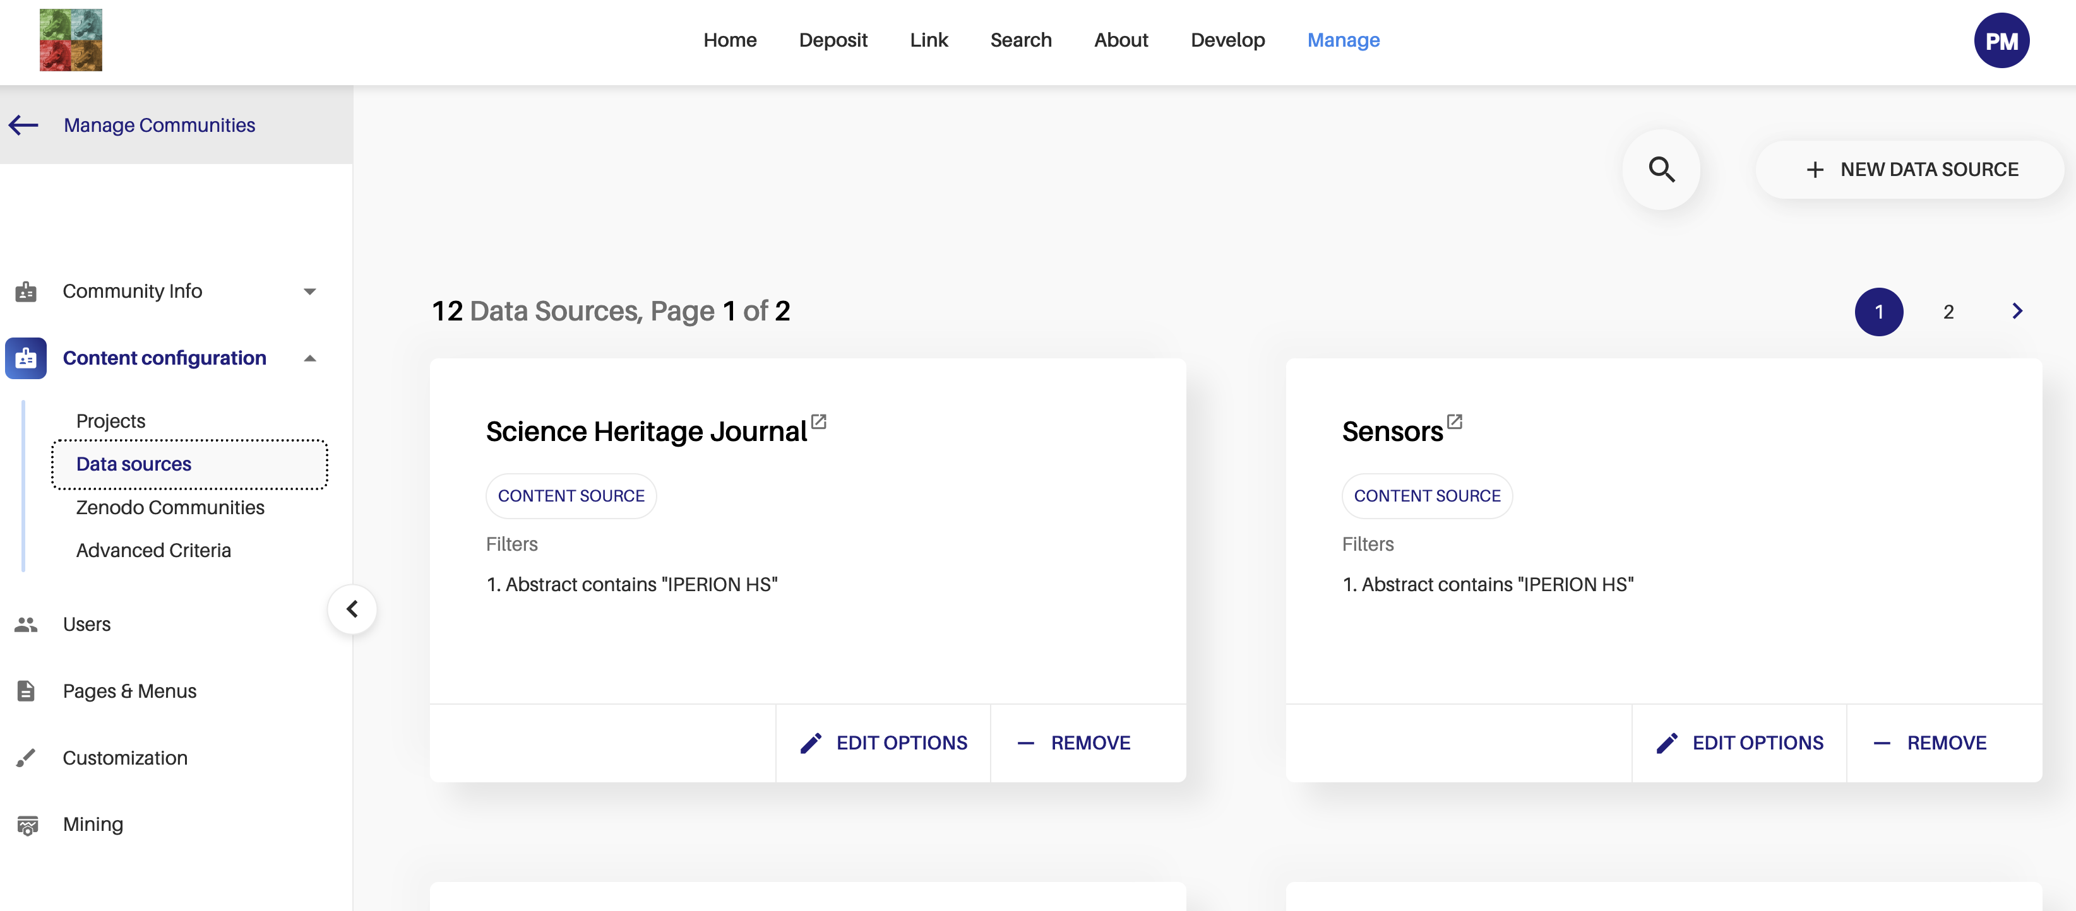
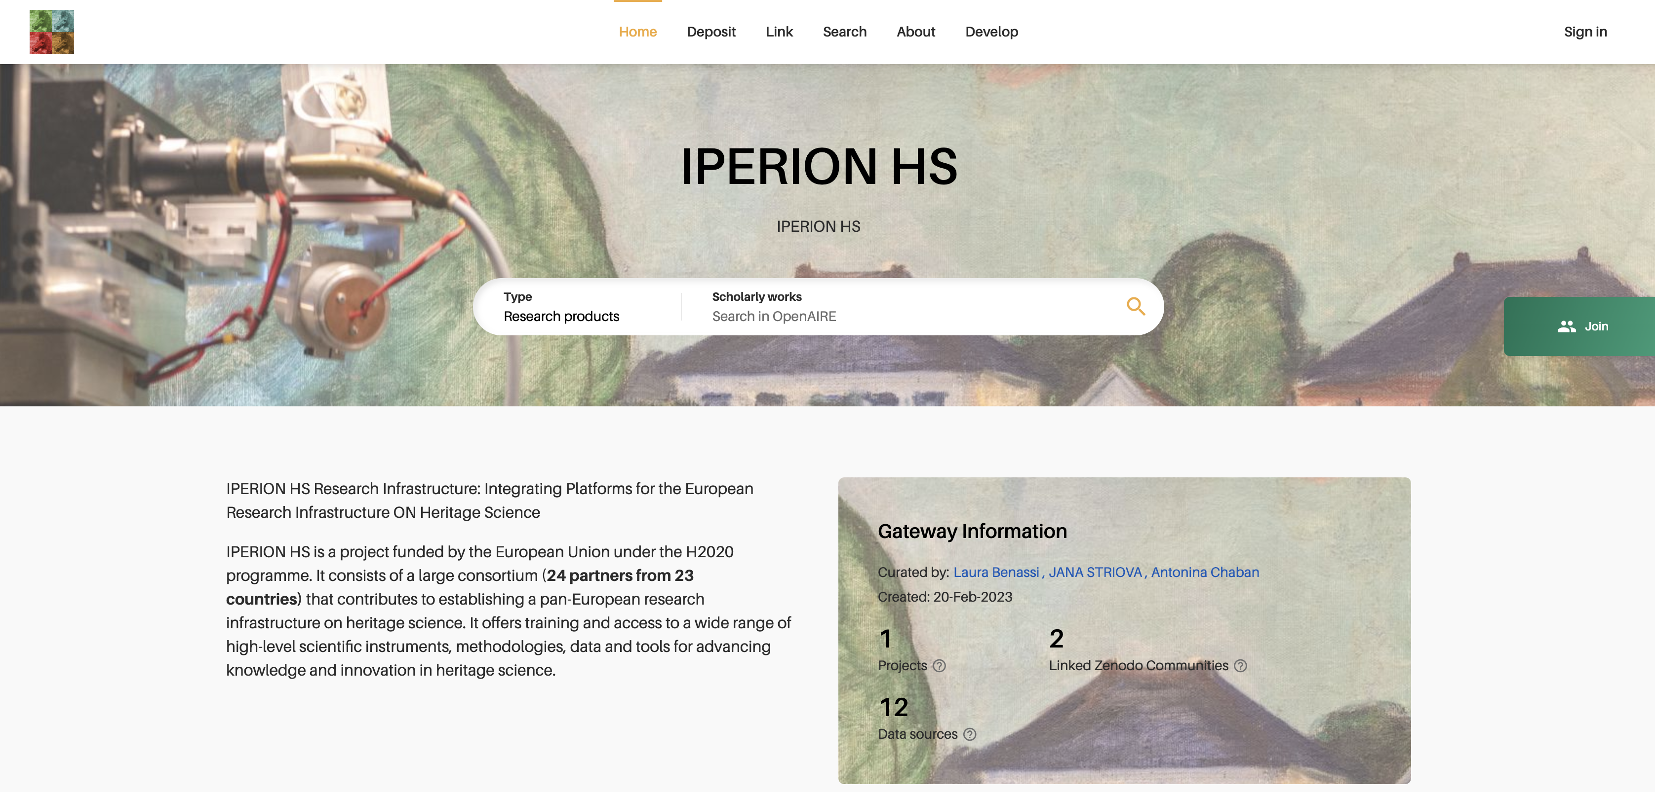
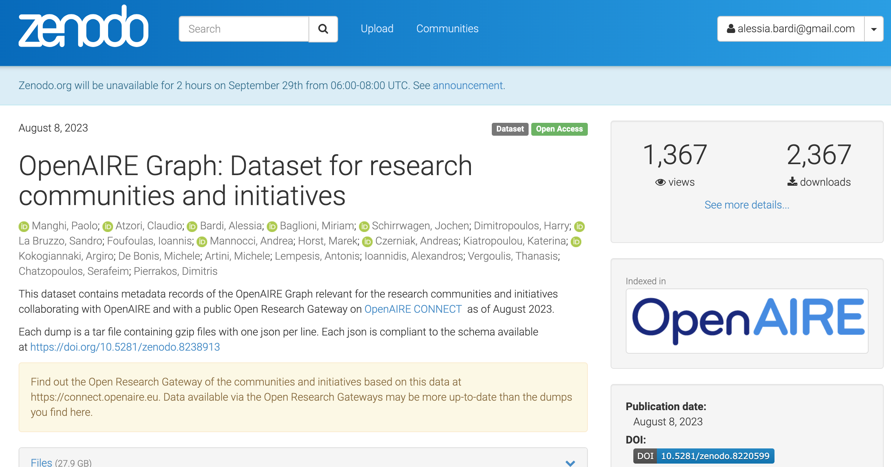
How Does CONNECT Work?
Community Gateway
Delivery
Gateway configuration
Identify relevant research products
https://doi.org/10.5281/zenodo.3974604
6

Slide 7
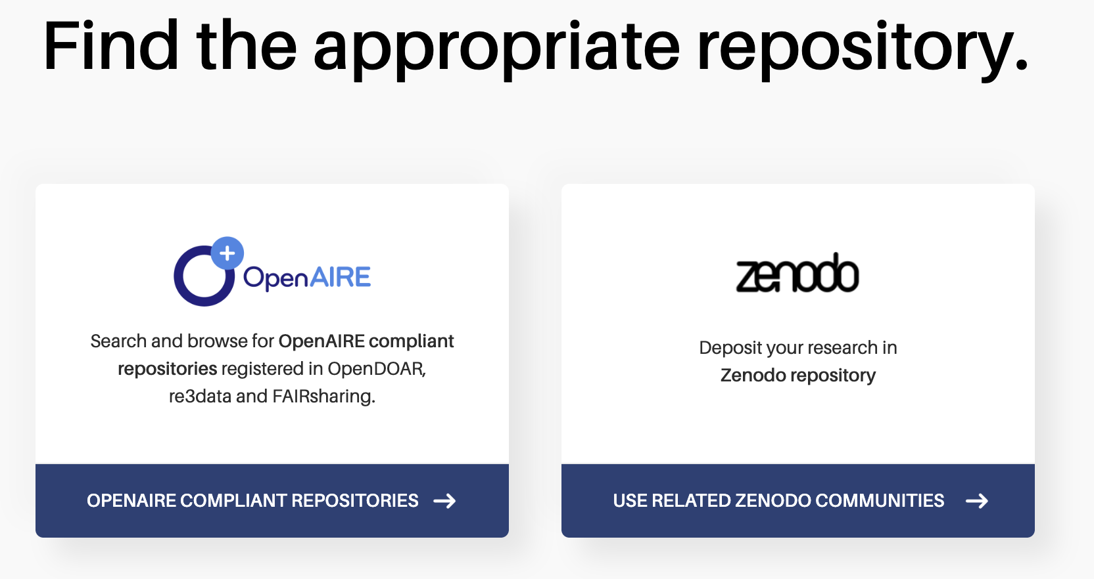
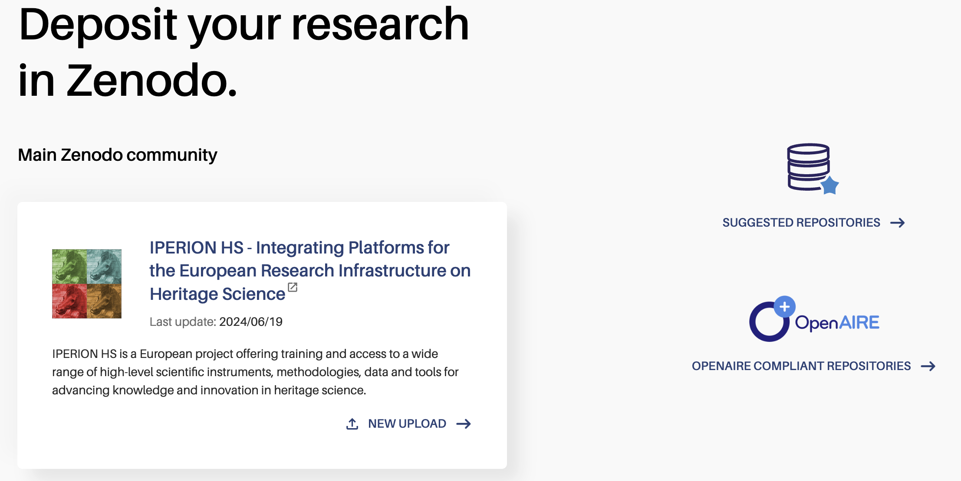
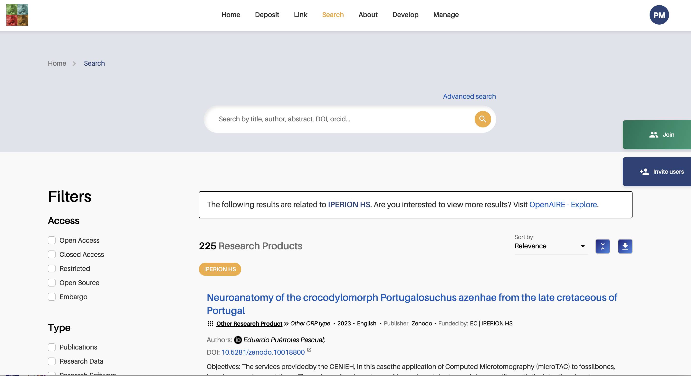
Breaking Down Barriers
It breaks down the barriers that hinder the adoption of Open Science publishing practices in the research community
Discovery in the literature and data deluge
Dispersion of research products
Lack of community awareness
Lack of Open Science publishing services and tools
OpenAIRE CONNECT is a tool for Open Science, community building and outreach
7

Slide 8
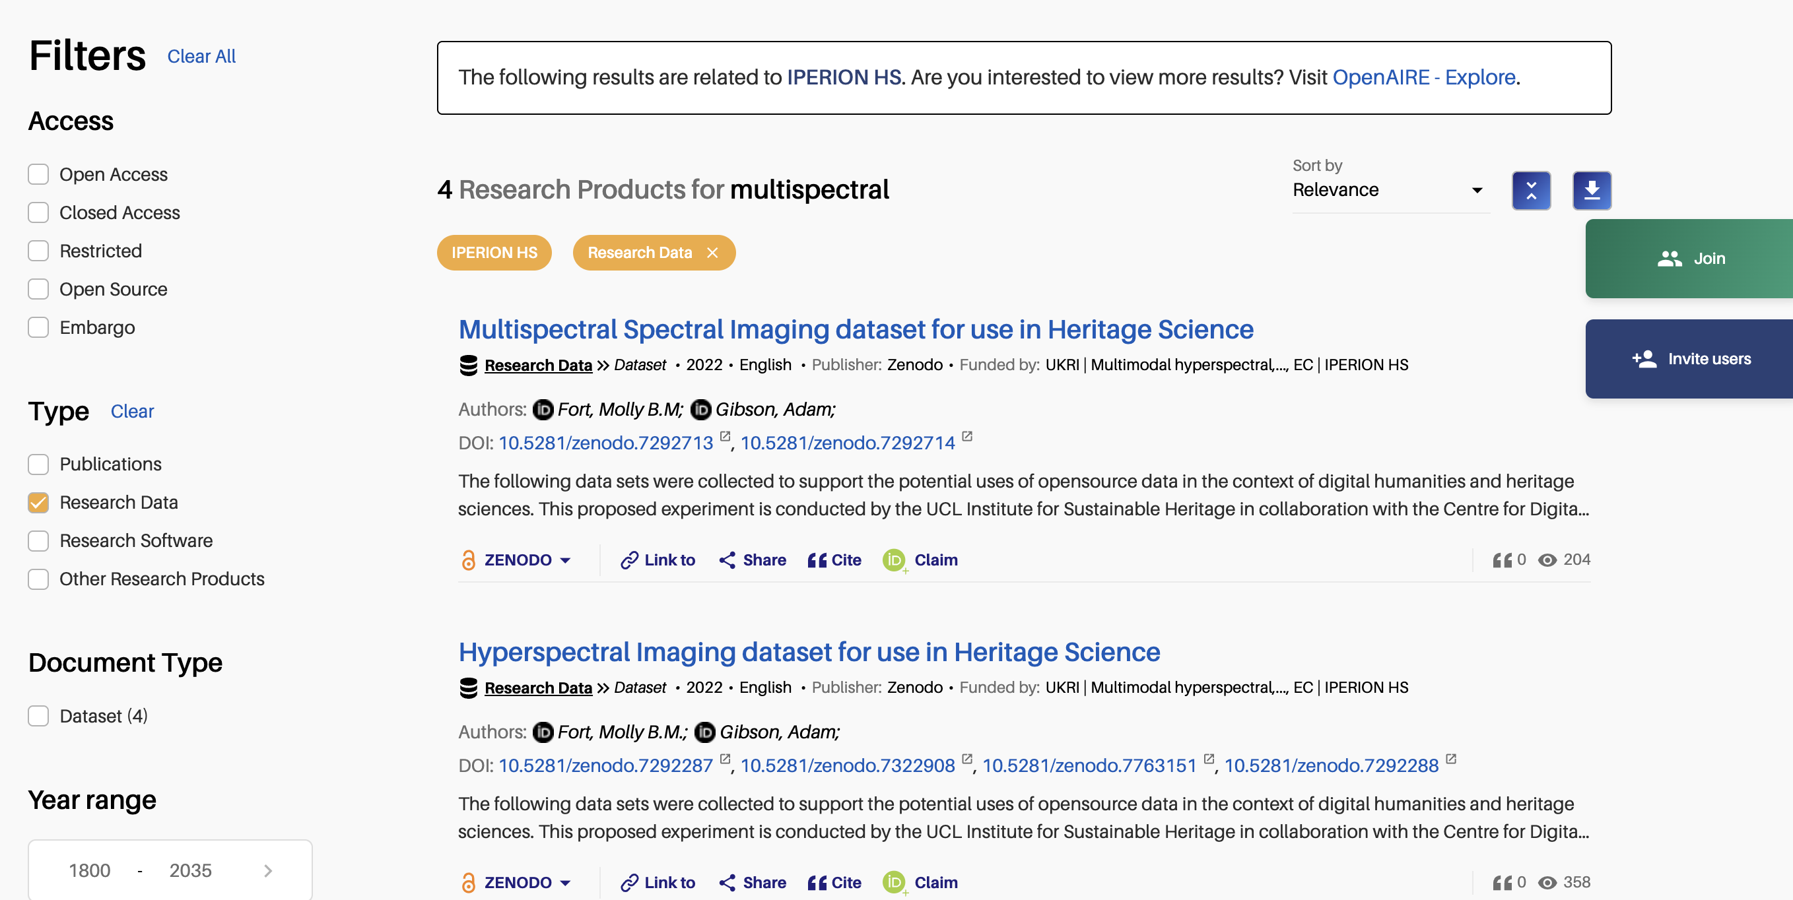
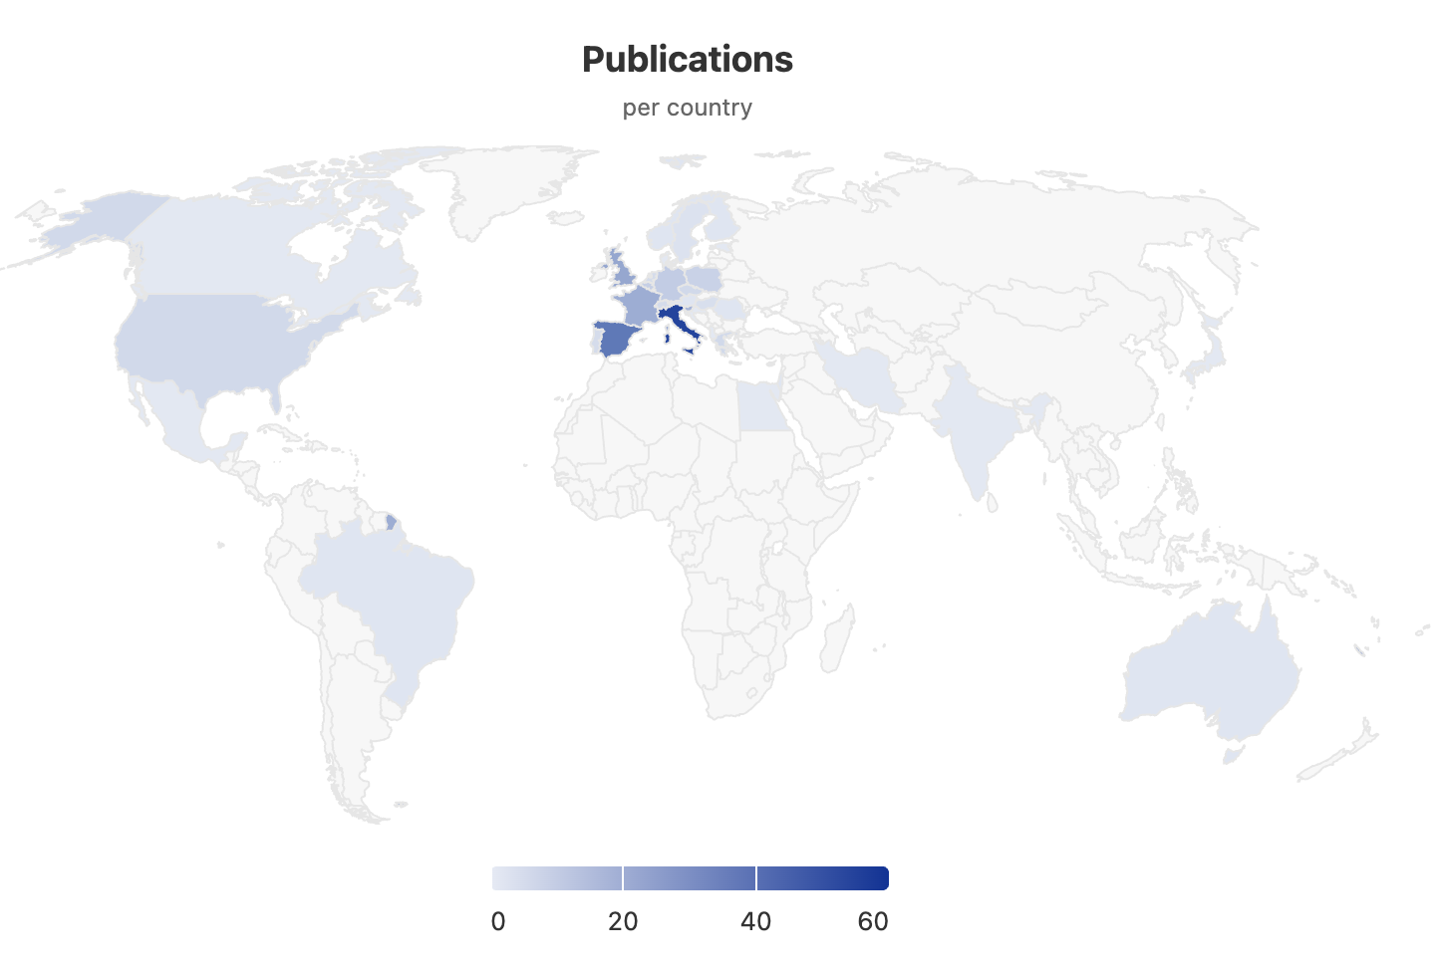
Comprehensive Portals
Branding capabilities
Custom view of the OpenAIRE Graph
Discovery and tracking
8

Slide 9
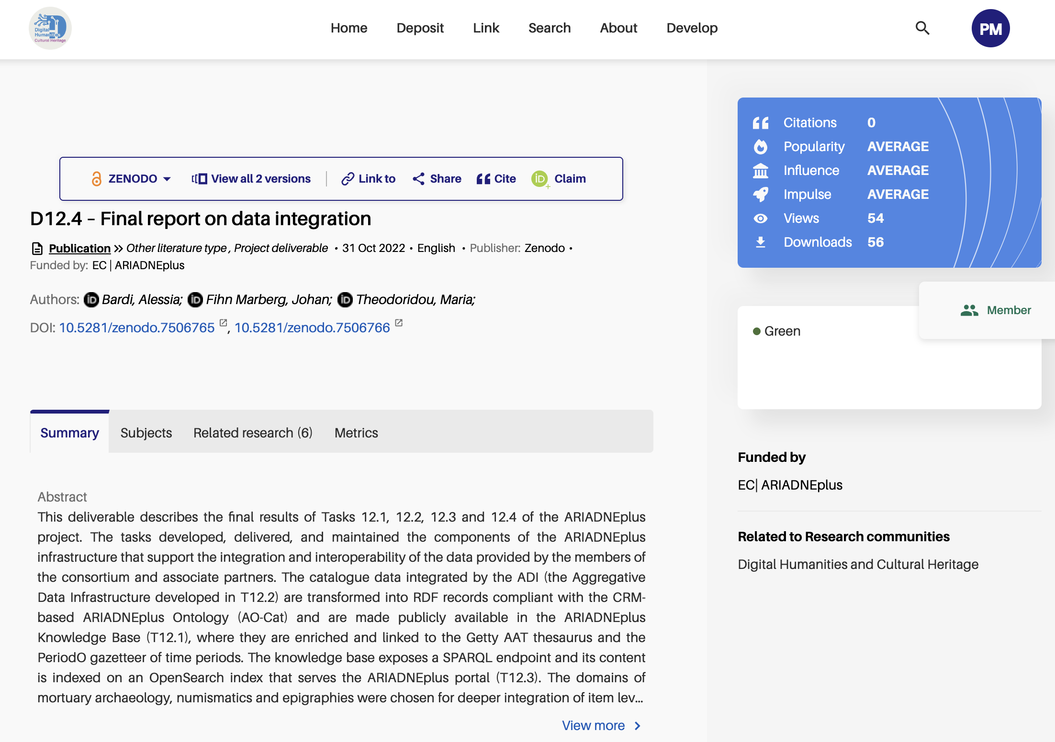
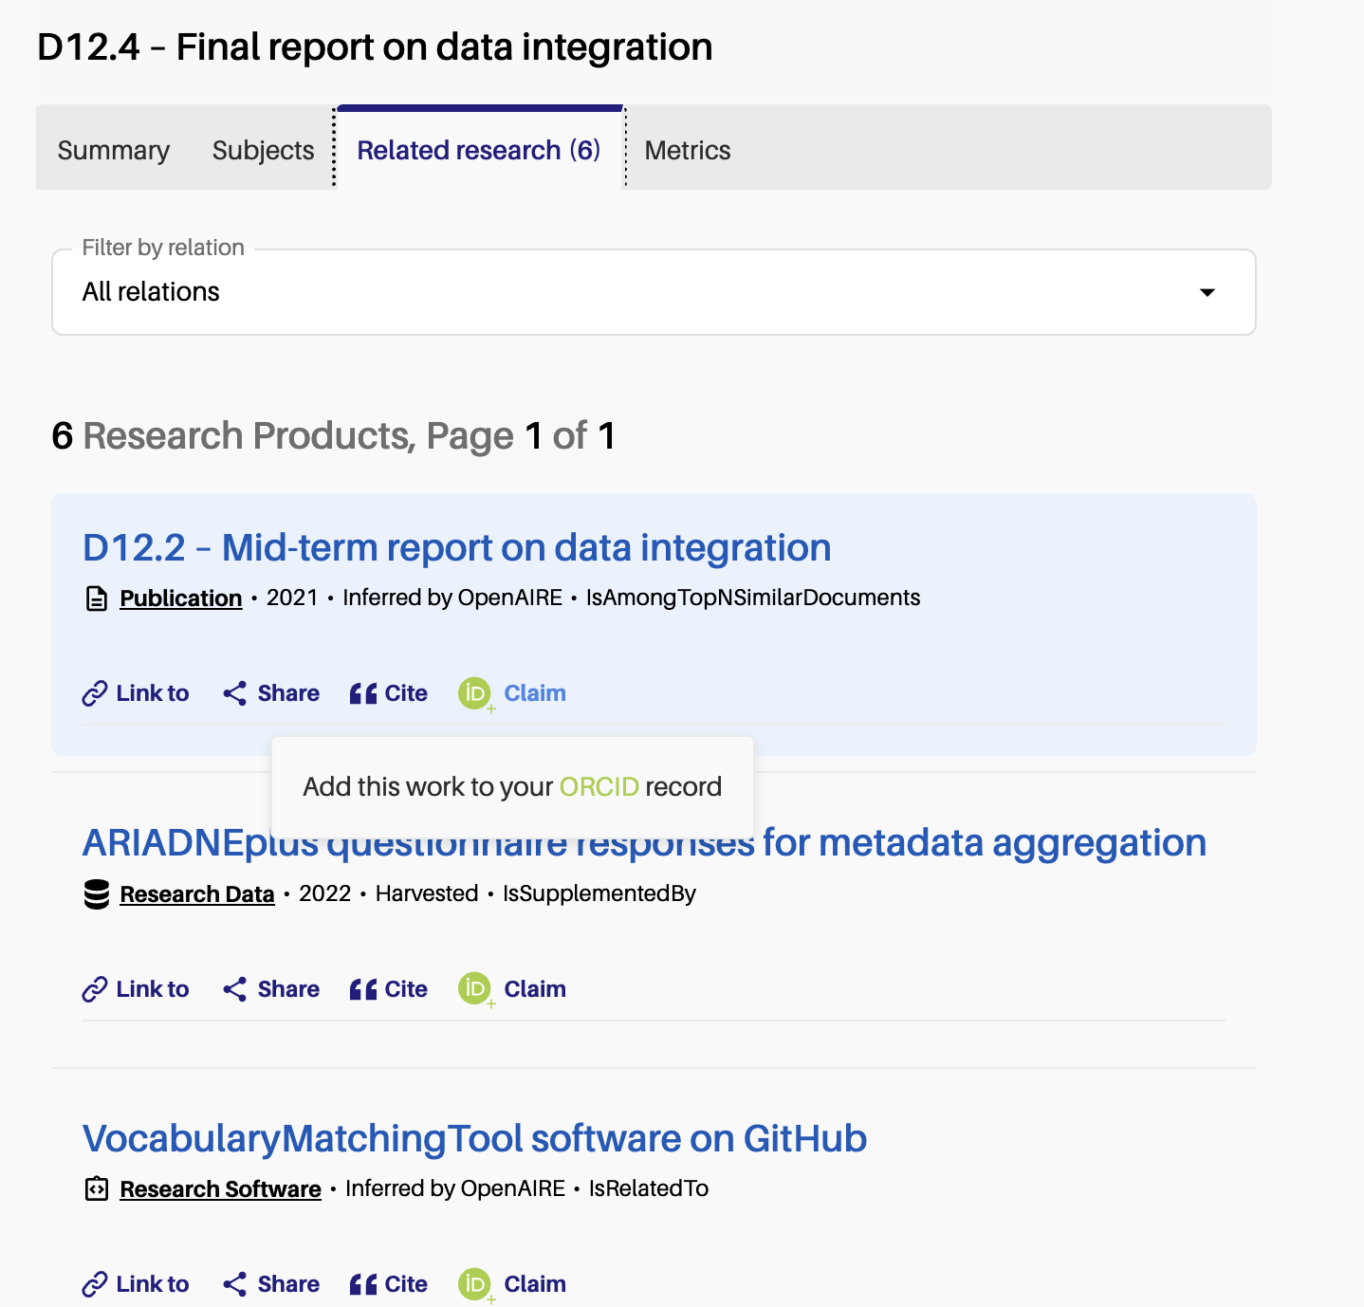
OpenAIRE CONNECT in Cultural Heritage
Knowledge Graph-flavoured semantic relationships
9

Slide 10
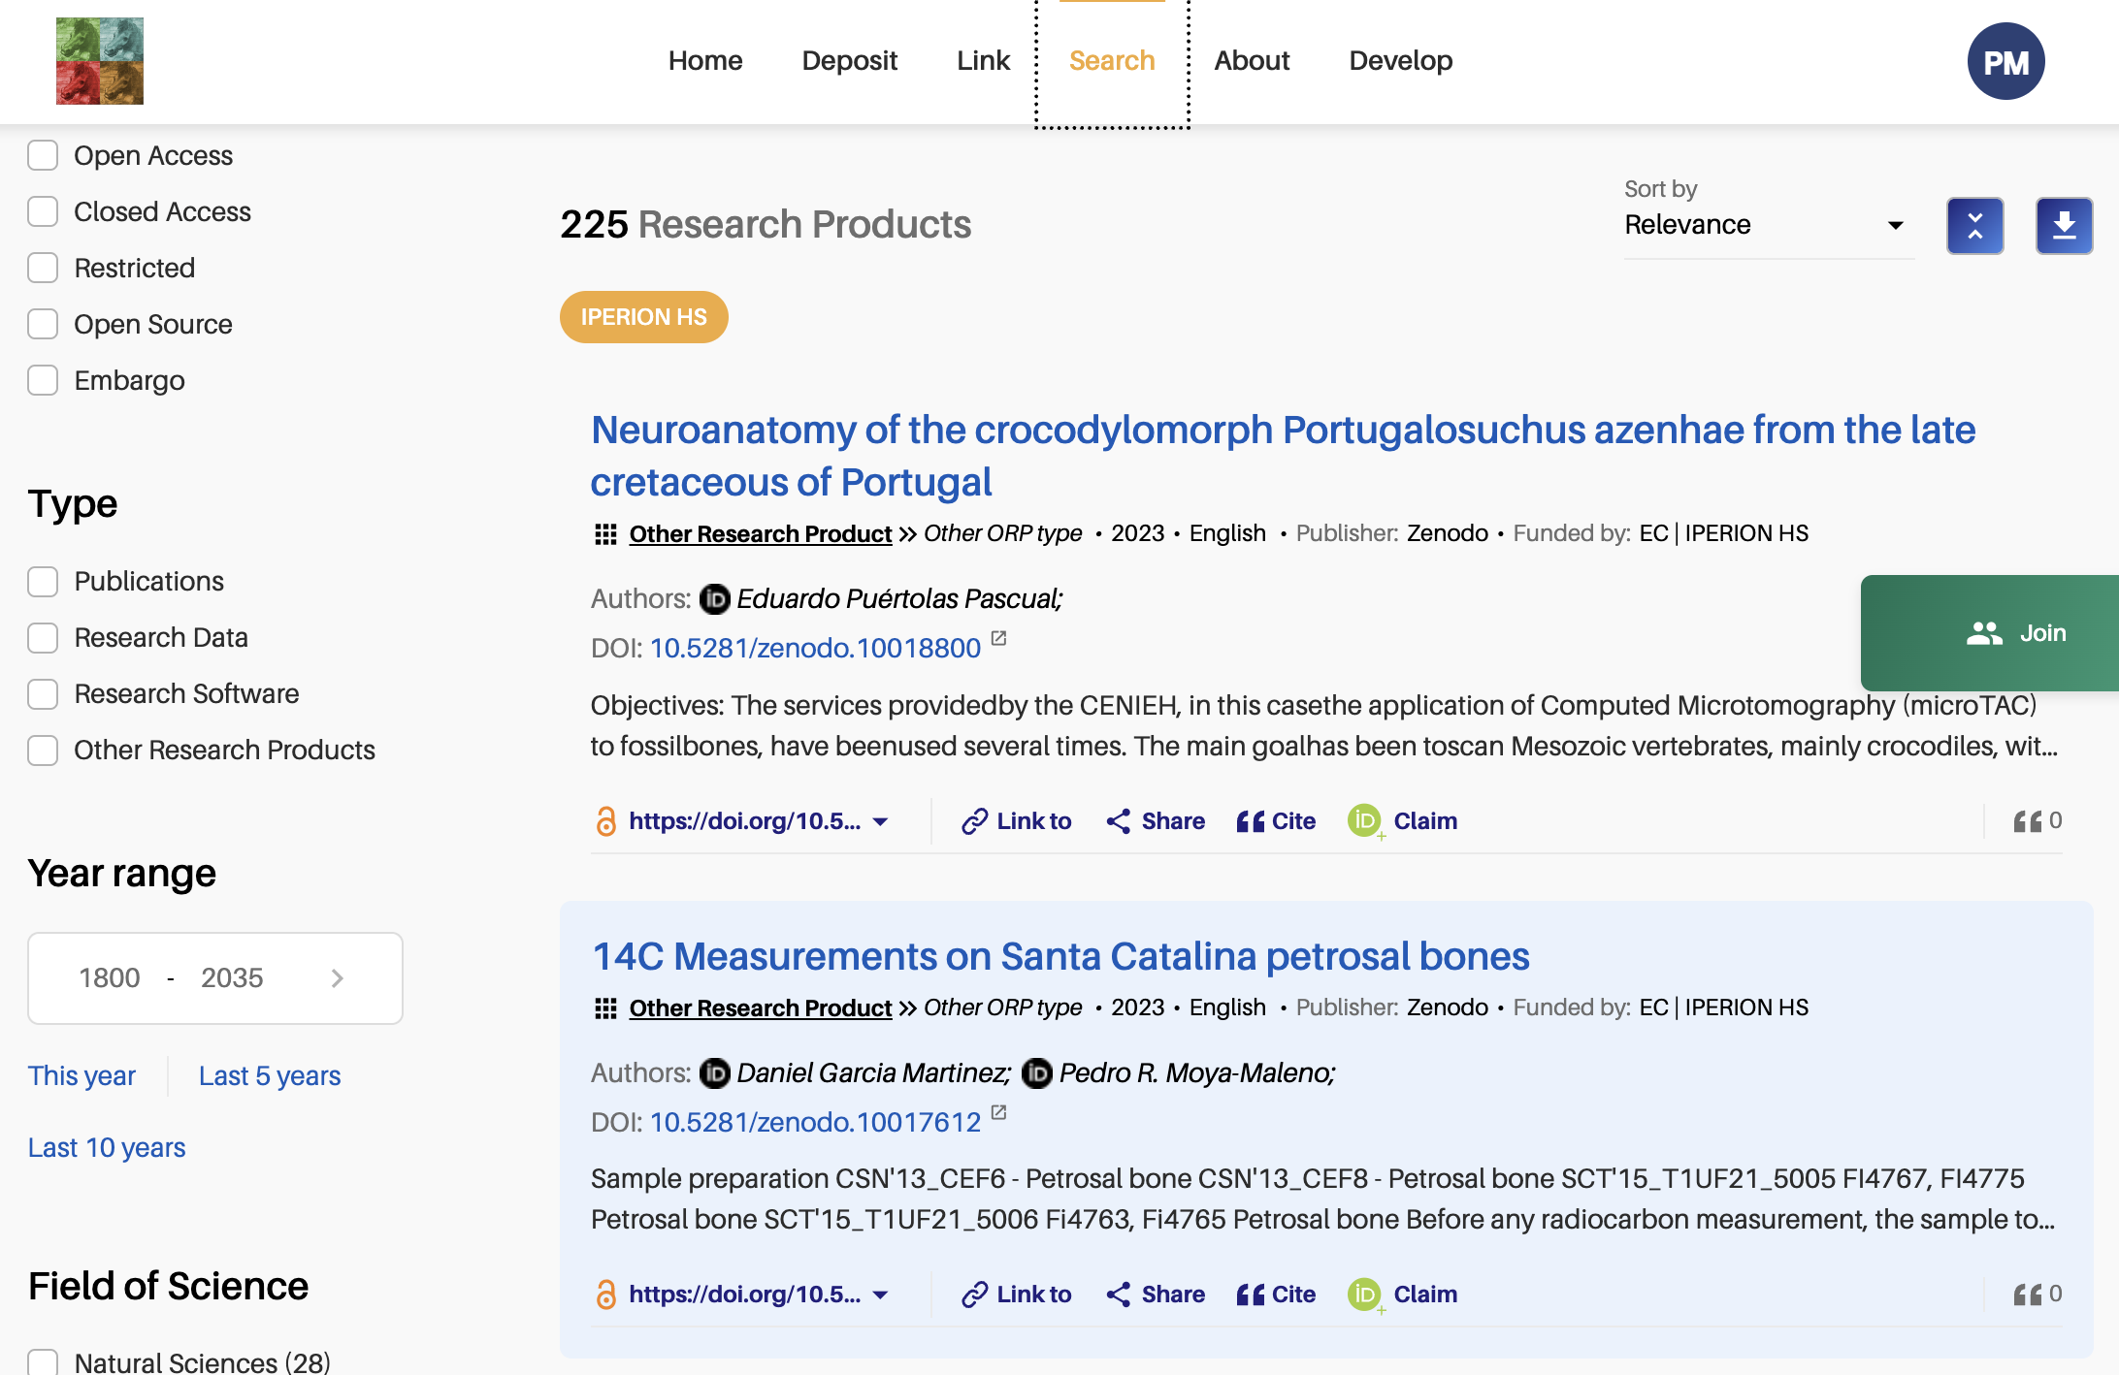
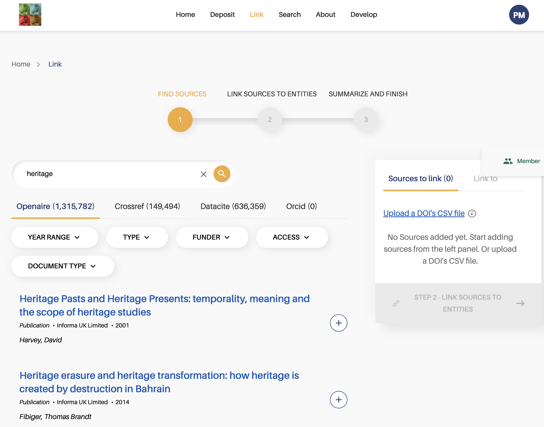
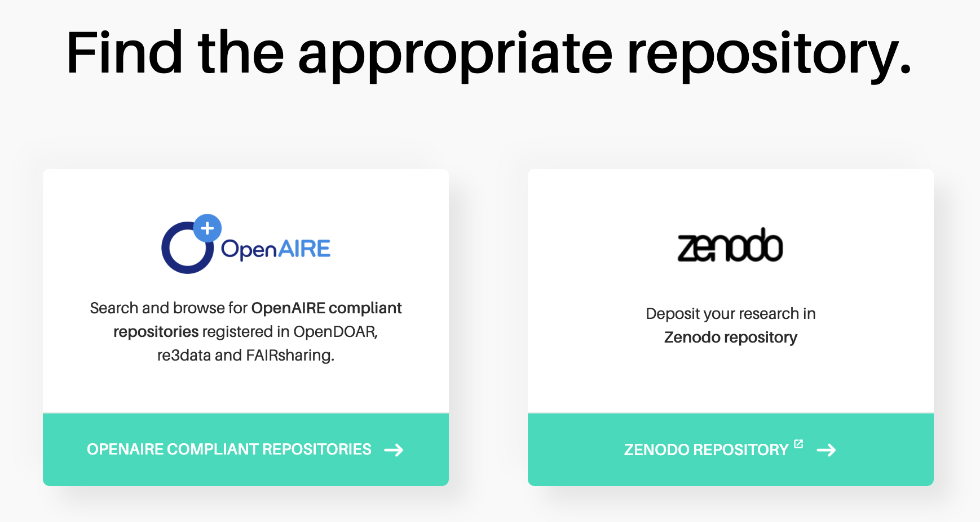
Facilitator of OS Practices
Linking & claiming research
Finding repositories
Sharing research
Open & FAIR metadata
10

Slide 11
Community Gateway Content Configuration
Keywords
Discipline-specific subject terms to be found in the metadata
Projects
From the 157 funders integrated in OpenAIRE
Data sources
E.g. thematic repositories, archives and journals
Zenodo communities
With research products relevant for the field
Gateway curators
Organisations
Organisations in the field: we look for them in the affiliations
Advanced criteria
Combine criteria in AND or OR, like in an advanced search
11

Slide 12
Community Gateway Content Configuration
Propagation
If a community result is supplemented by another research product, then the latter is also added in the community gateway
Custom Full-text mining
Publications related to community “concepts”
OpenAIRE algorithms
Graph Full-text mining
Links to projects Affiliations
Document classification
. . .
12

Slide 13
Community Gateway Content Configuration
Link
Link products in OpenAIRE, Crossref, Datacite, ORCID to the community, also in bulk
Community curators
Researchers
Curate
Verify or peer review content, interact with researchers to improve metadata
13

Slide 14
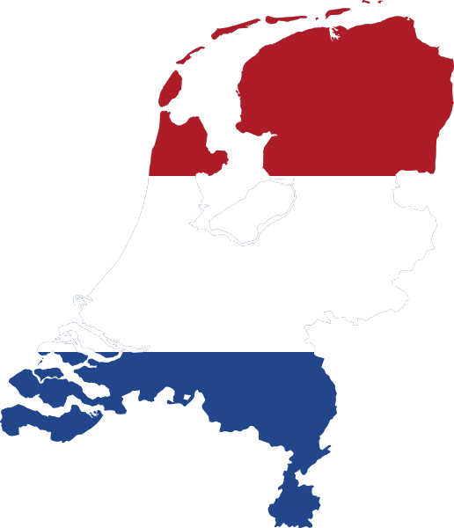
Who’s Using OpenAIRE CONNECT
National initiatives
University Alliances
52 Gateways in March 2025 (+8% since June 2024)
Projects and research networks
Research infrastructures
Discover more: https://connect.openaire.eu/search/find/communities
14

Slide 15
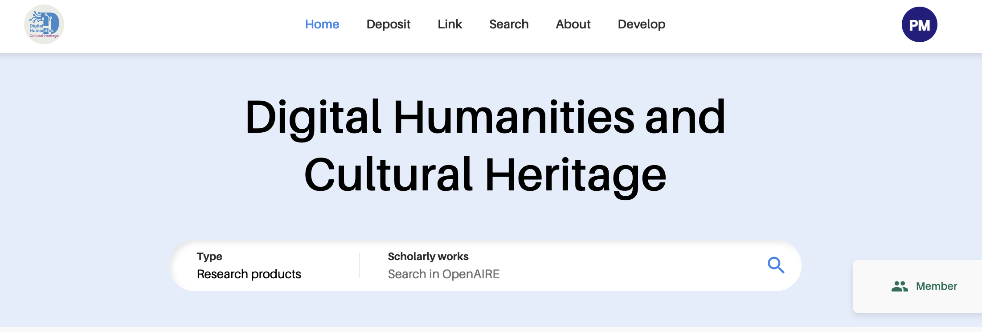
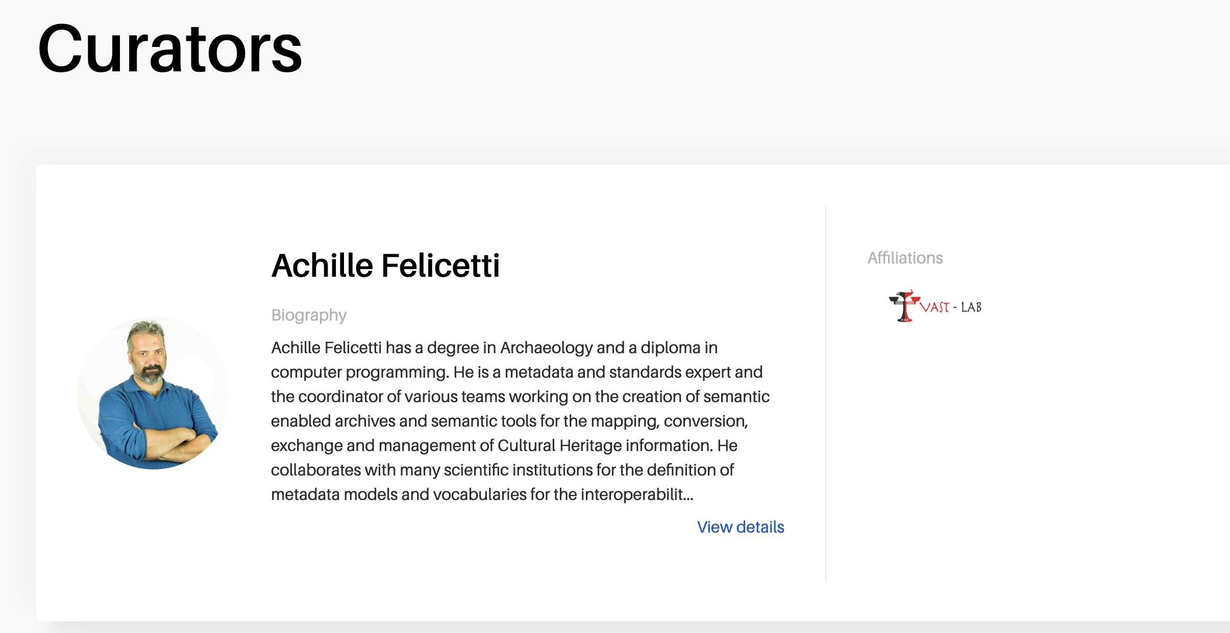
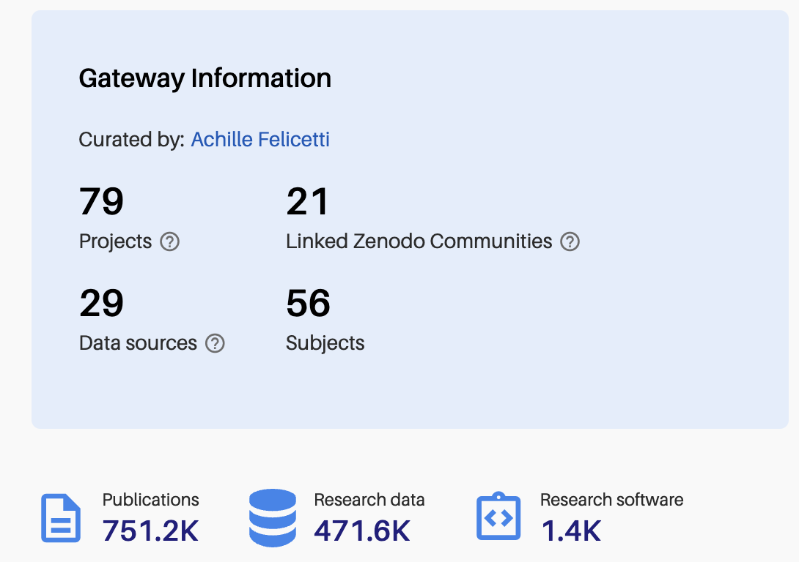
OpenAIRE CONNECT in Cultural Heritage
https://dh-ch.openaire.eu/: This community gathers research results, data, scientific publications and projects related to the domain of Digital Humanities. This broad definition includes Humanities, Cultural Heritage, History, Archaeology and related fields. One of the first community with an OpenAIRE Gateway, started in the context of the OpenAIRE CONNECT project in 2017
15

Slide 16
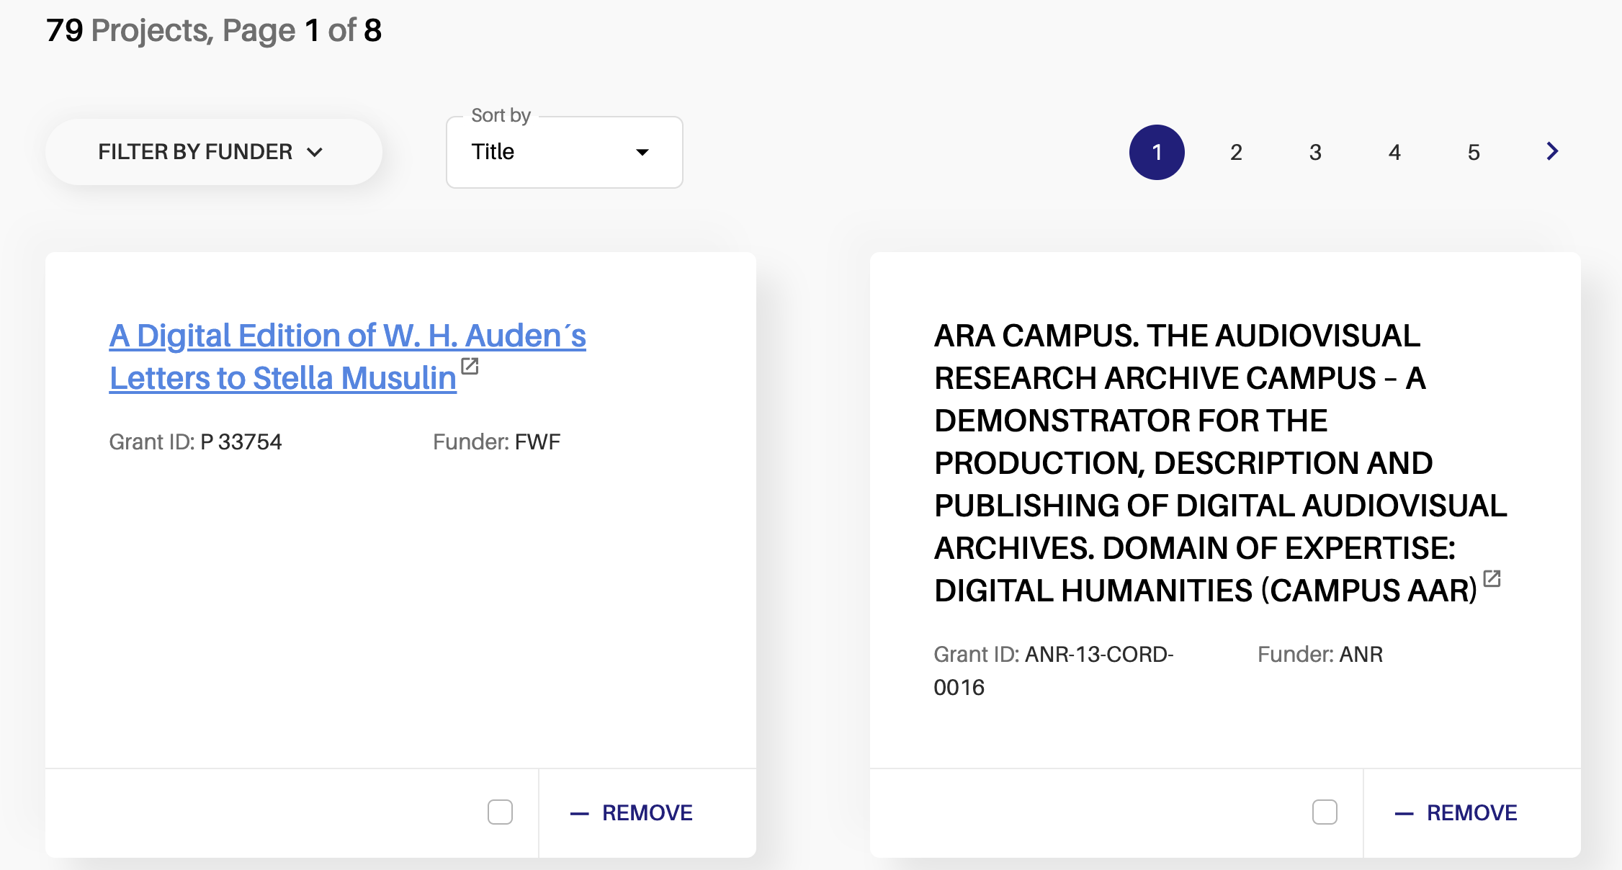
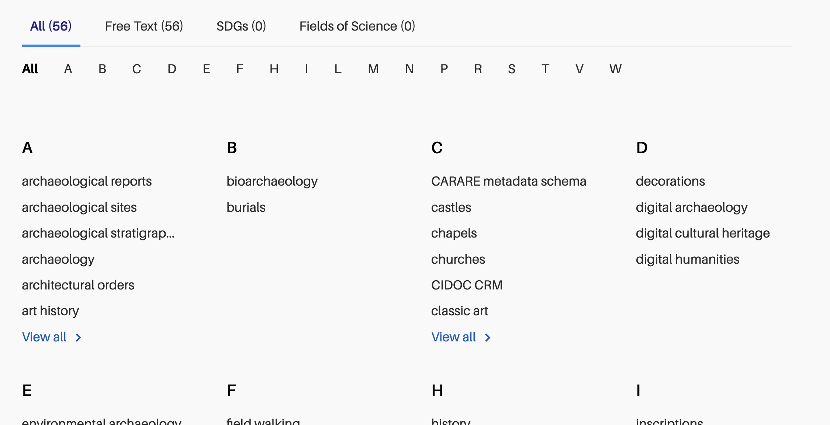
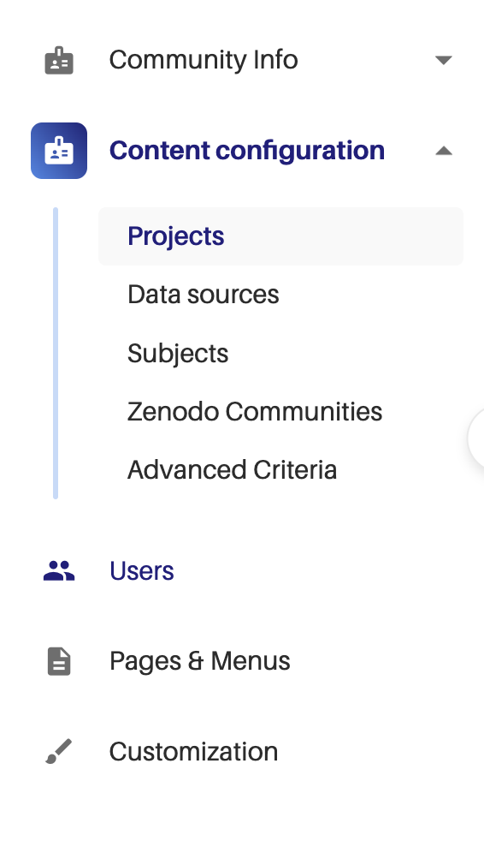
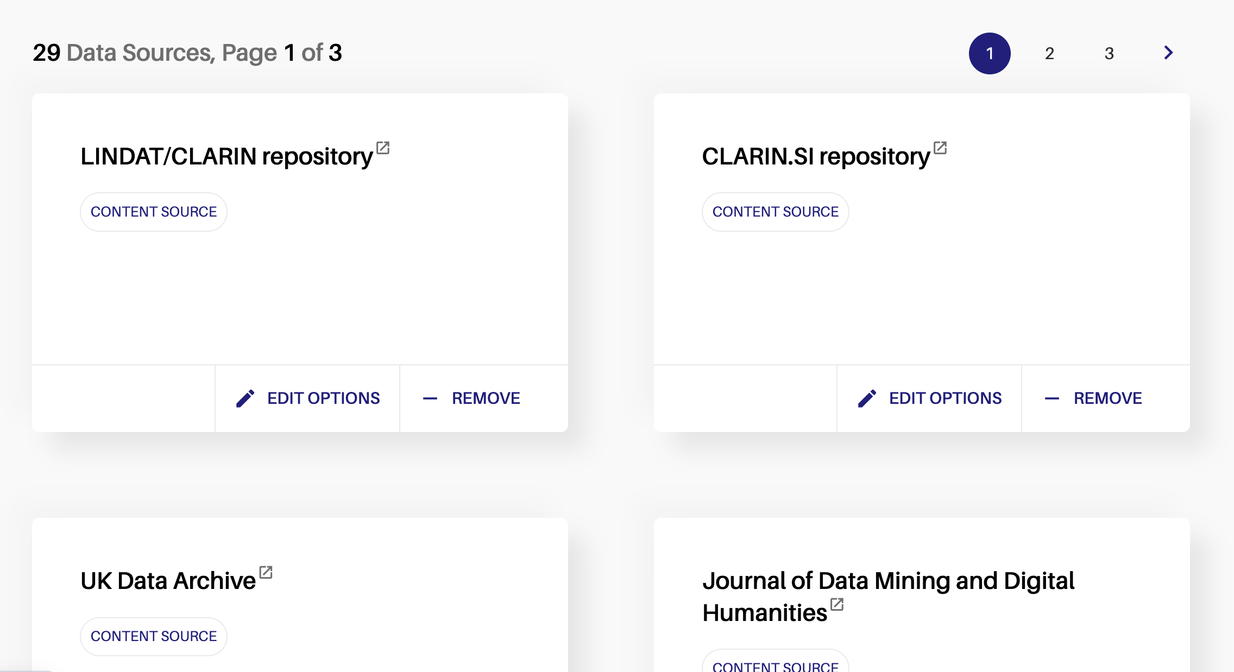
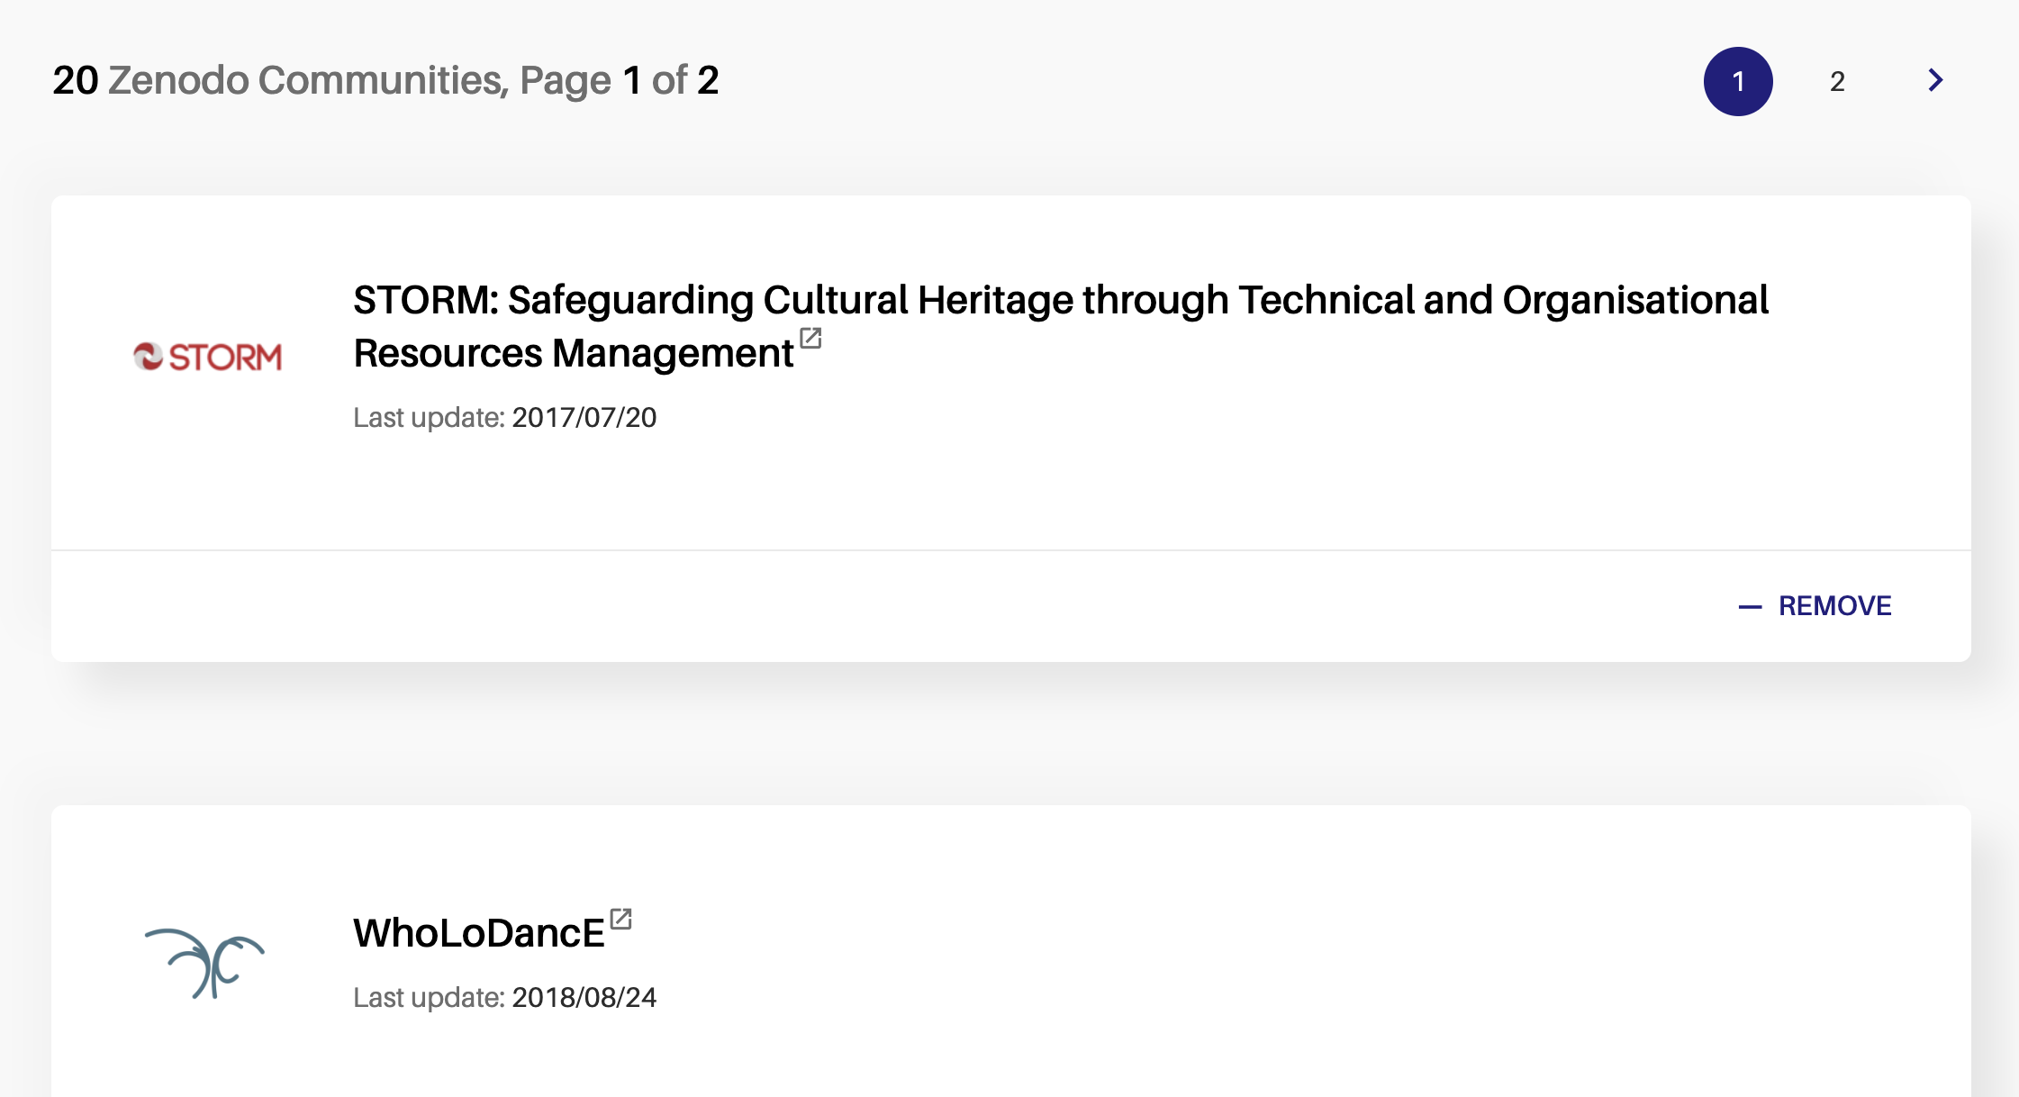
OpenAIRE CONNECT in Cultural Heritage
16

Slide 17
OpenAIRE CONNECT in Cultural Heritage
65%
751,179 publications
(550,766 Open Access)
471,606 datasets
(300,497 Open Access)
Publication – datasets rels in the community
1,416 software
(478 Open Access)
3908 | IsSupplementedBy
3440 | HasPart
2188 | IsPartOf
2153 | References
1029 | Cites
349 | Documents
348 | IsReferencedBy
89 | IsDocumentedBy
218,867 other kinds of products
(96,033 Open Access)
17

Slide 18
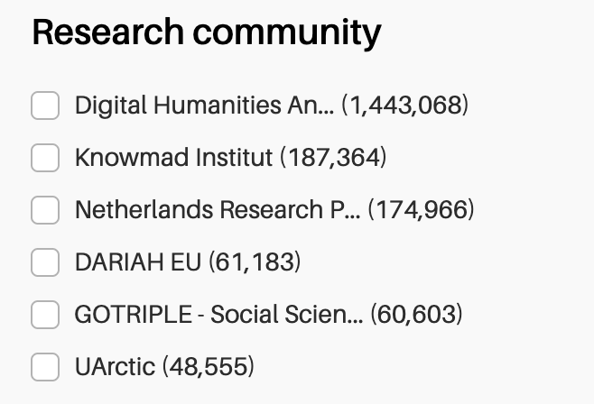
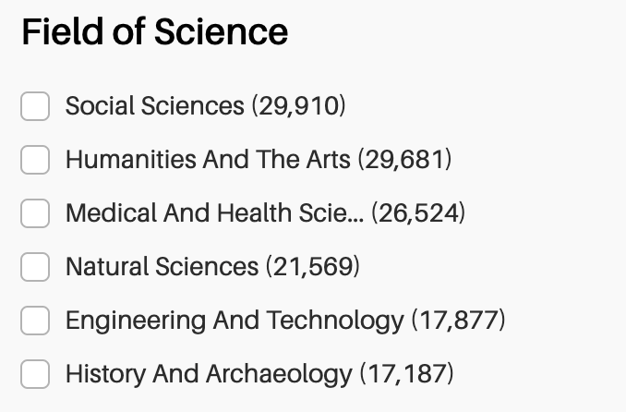
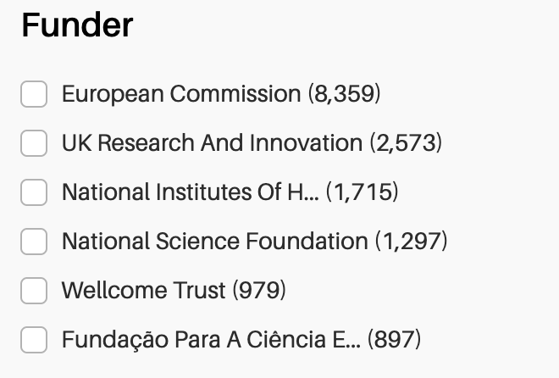
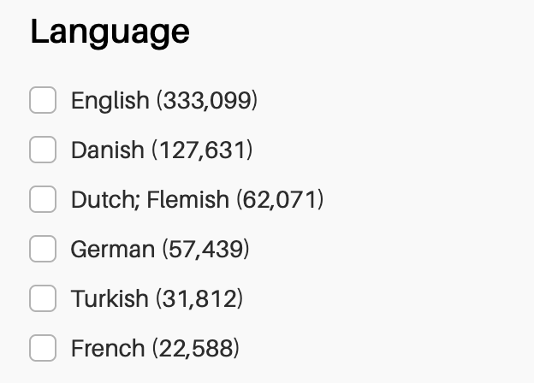
OpenAIRE CONNECT in Cultural Heritage
18

Slide 19
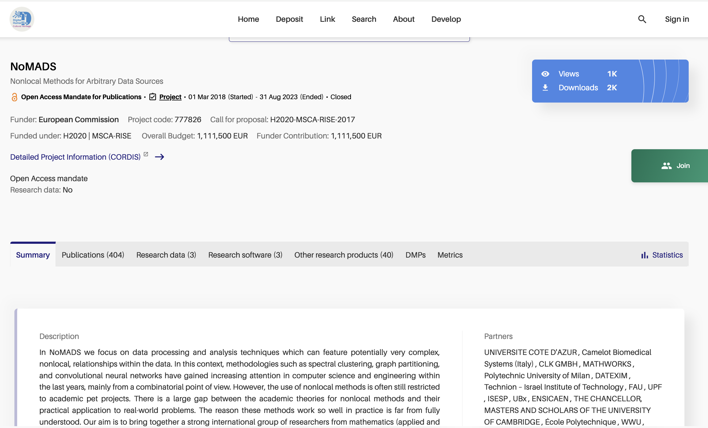
OpenAIRE CONNECT in Cultural Heritage
19

Slide 20
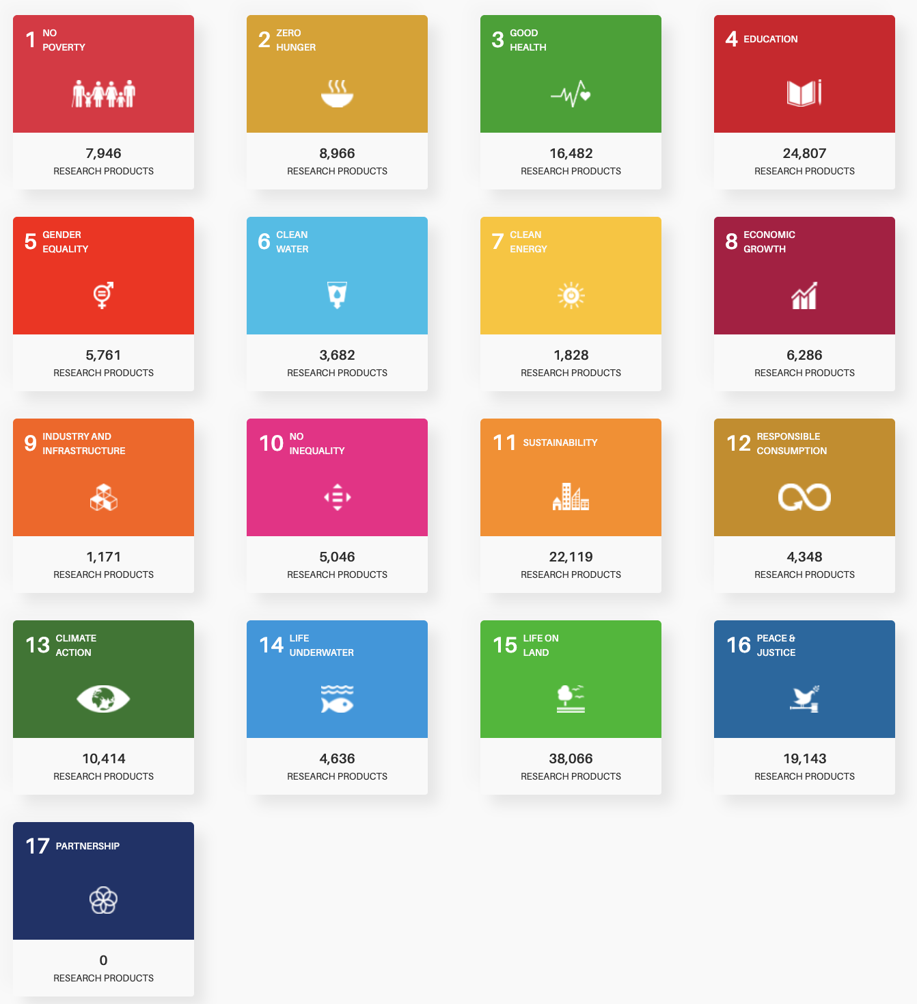
OpenAIRE CONNECT in Cultural Heritage
20

Slide 21
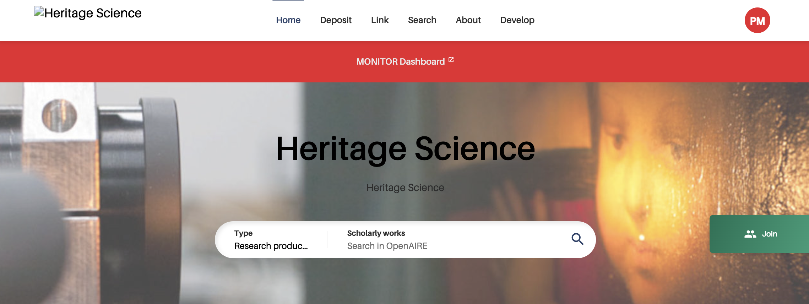
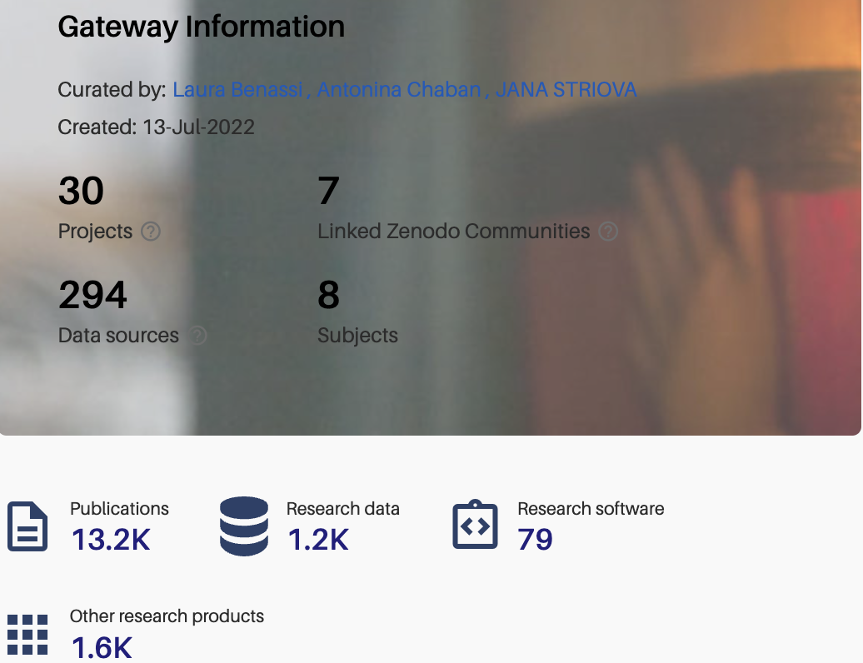
OpenAIRE CONNECT in Cultural Heritage
https://heritage-science.openaire.eu/: The gateway aims at including all the relevant research outcomes in the field of Heritage Science, the interdisciplinary domain of scientific study of cultural or natural heritage. The gateway was created with the IPERION HS Research Infrastructure EU project. An OpenAIRE MONITOR Dashboard analyses the records in the gateway to provide indicators about the uptake of Open Science practices within the research community.
21

Slide 22
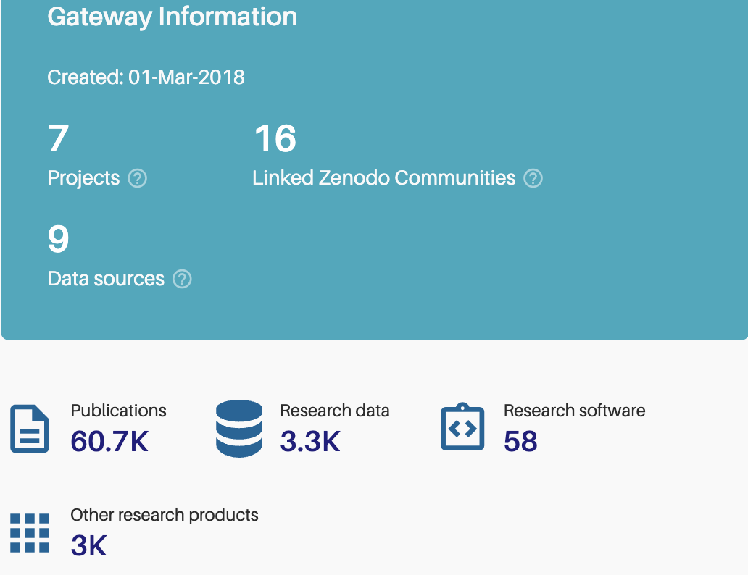
OpenAIRE CONNECT in Cultural Heritage
https://dariah.openaire.eu/: a growing collection of DARIAH-affiliated research outputs and related documents. The gateway was set up with DARIAH EU during the OpenAIRE Advance project in 2018. An OpenAIRE MONITOR Dashboard analyses the records in the gateway to provide indicators about the impact of DARIAH.
22

Slide 23
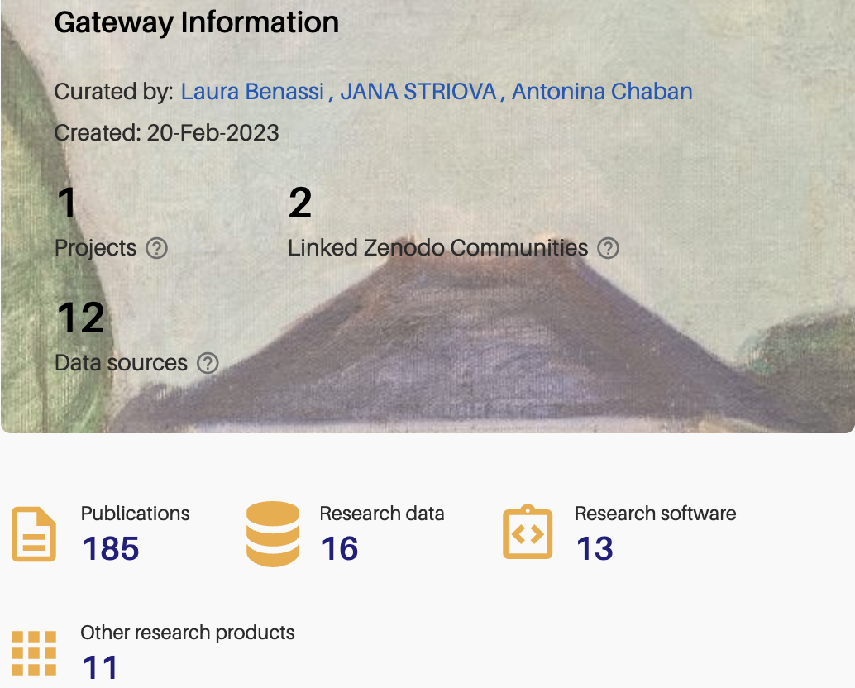
OpenAIRE CONNECT in Cultural Heritage
https://iperionhs.openaire.eu/: the gateway includes research outputs of the IPERION HS Research Infrastructure EU project and related objects. An OpenAIRE MONITOR Dashboard analyses the records in the gateway to provide indicators about the impact of the project.
23

Slide 24
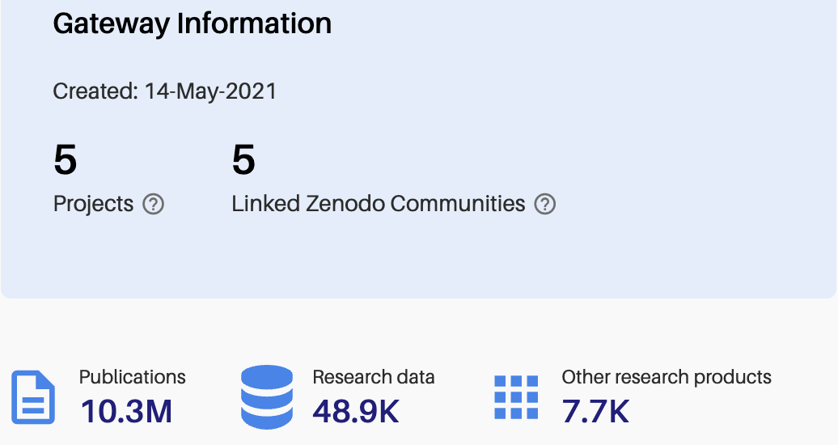
OpenAIRE CONNECT in Cultural Heritage
https://gotriple.openaire.eu/: a work in progress in collaboration with OPERAS to identify the subset of the OpenAIRE Graph related to Social Sciences and Humanities. The identified research products will feed into the GoTriple Platform (https://www.gotriple.eu/)
24

Slide 25
Thank you
alessia.bardi@isti.cnr.it
paolo.manghi@openaire.eu
@OpenAIRE_EU

